Slide 1

License Plate Recognition
By: Alejandro Chavez and JESSE mORENO

Slide 2

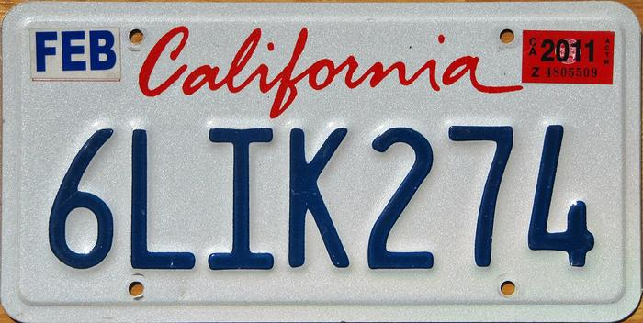
Goal
Our goal was to extract the plate number from a California license plate.
We did this by using morphological operations.

Slide 3
Issues
We focused on using what we had at hand which was the knowledge of morphological operations
We realized that this code would not be reusable for other license plates because of size issues and hit and miss not working for the letter L.
L was being picked up twice. We resolved that by cropping out the section where the unwanted L was being found by erosion.

Slide 4
Issues
Input
Original Image
Process Image
Morphological Operation
Output
Text stored in string

Slide 5
Process
Step 1: Perform morphological operation to remove unwanted text.
Step 2: Use region prop to create structuring elements.
Step 3: Use morphically operation, mainly erosion, to detect letters using structing elements created in previous step.
Step 4: Create an if statement that tells us if a letter was found.

Slide 6
Demo
Demo time!

